Slide 1
Hypothesis Testing
Dr. Shafayat Abrar

Slide 2
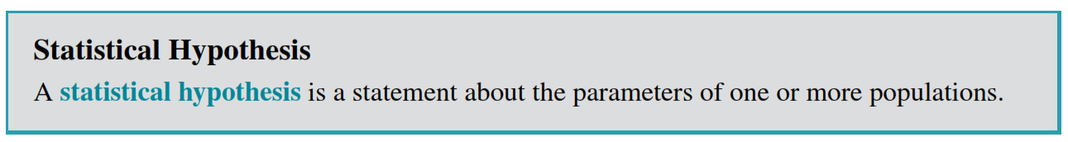
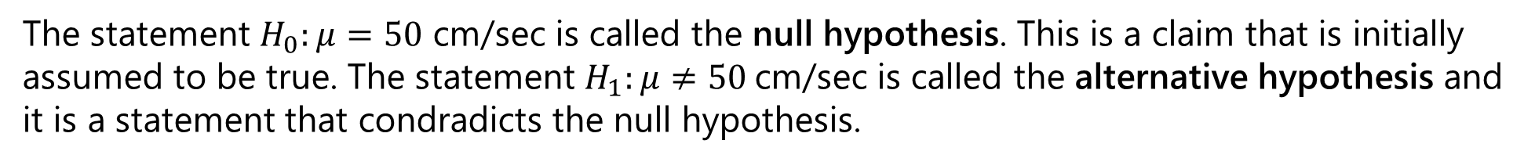
Statistical Hypotheses
As we use probability distributions to represent data or populations, a statistical hypothesis may be thought of as a statement about the probability distribution of a random variable. The hypothesis usually involves one or more parameters of this distribution.
Consider a rocket. Suppose that we are interested in the burning rate of the solid propellant. Burning rate is a random variable that can be described by a probability distribution. Suppose that our interest focuses on the mean burning rate (a parameter of this distribution). Speciﬁcally, we are interested in deciding whether or not the mean burning rate is 50 centimeter-per-second. We may express this formally as
The statement $H_{0}:μ=50$ cm/sec is called the null hypothesis. This is a claim that is initially assumed to be true. The statement $H_{1}:μ≠50$cm/sec is called the alternative hypothesis and it is a statement that condradicts the null hypothesis.

Slide 3
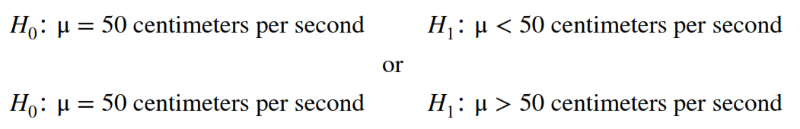
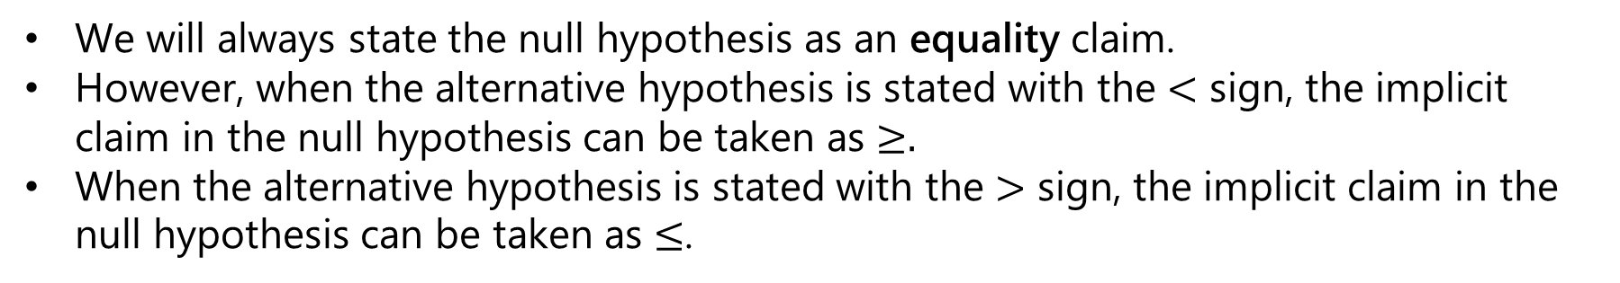
Because the alternative hypothesis speciﬁes values of $μ$ that could be either greater or less than 50 cm/sec, it is called a two-sided alternative hypothesis.
In some situations, we may wish to formulate a one-sided alternative hypothesis, as in
We will always state the null hypothesis as an equality claim.
However, when the alternative hypothesis is stated with the $<$ sign, the implicit claim in the null hypothesis can be taken as $≥.$
When the alternative hypothesis is stated with the $>$ sign, the implicit claim in the null hypothesis can be taken as $≤$.

Slide 4
It is important to remember that hypotheses are always statements about the population or distribution under study, not statements about the sample.
The value of the population parameter speciﬁed in the null hypothesis (50 cm/sec in the preceding example) is usually determined in one of three ways:
First, it may result from past experience or knowledge of the process or even from previous tests or experiments. The objective of hypothesis testing, then, is usually to determine whether the parameter value has changed.
Second, this value may be determined from some theory or model regarding the process under study. Here the objective of hypothesis testing is to verify the theory or model.
A third situation arises when the value of the population parameter results from external considerations, such as design or engineering speciﬁcations, or from contractual obligations. In this situation, the usual objective of hypothesis testing is conformance testing.

Slide 5
A procedure leading to a decision about the null hypothesis is called a test of a hypothesis.
Hypothesis-testing procedures rely on using the information in a random sample from the population of interest.
If this information is consistent with the null hypothesis, we will not reject it; however, if this information is inconsistent with the null hypothesis, we will conclude that the null hypothesis is false and reject it in favour of the alternative.
We emphasize that the truth or falsity of a particular hypothesis can never be known with certainty unless we can examine the entire population. This is usually impossible in most practical situations.
Therefore, a hypothesis-testing procedure should be developed with the probability of reaching a wrong conclusion in mind. Testing the hypothesis involves taking a random sample, computing a test statistic from the sample data, and then using the test statistic to make a decision about the null hypothesis.

Slide 6
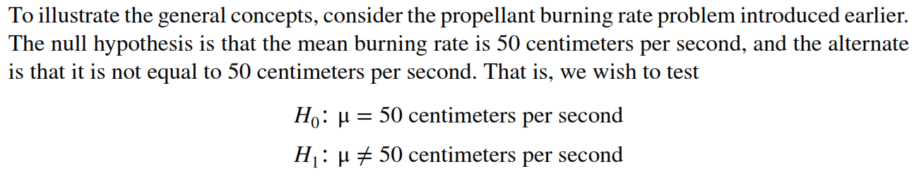
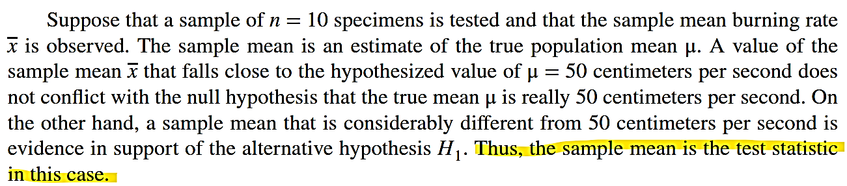
Tests of Statistical Hypotheses

Slide 7
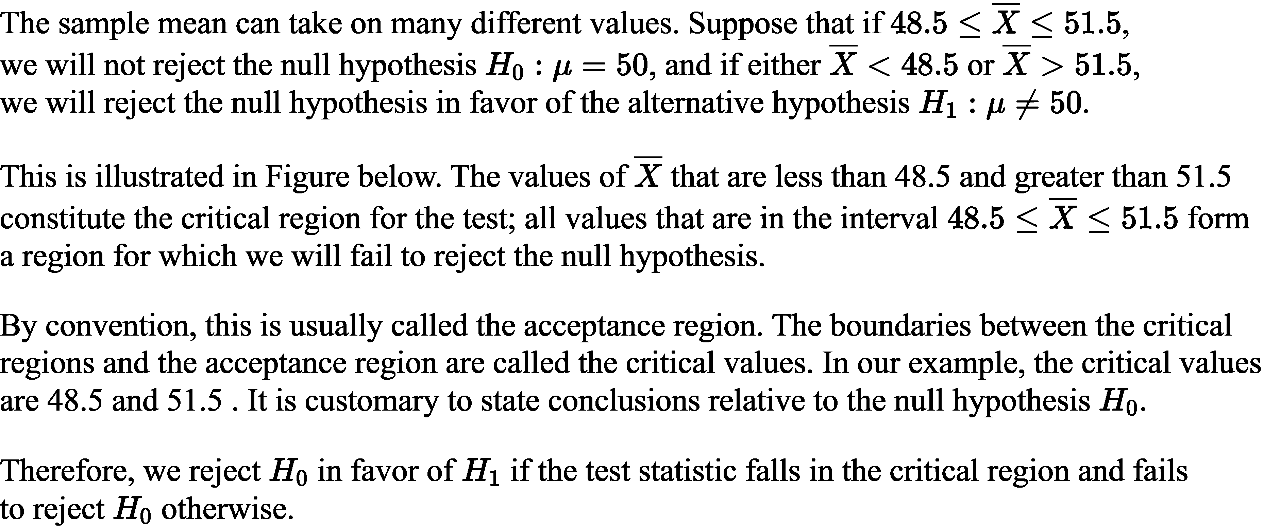
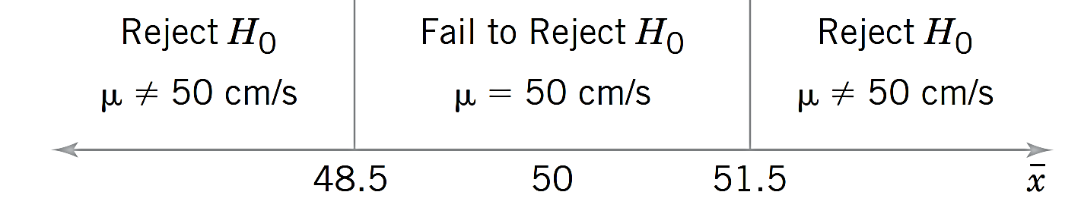

Slide 8
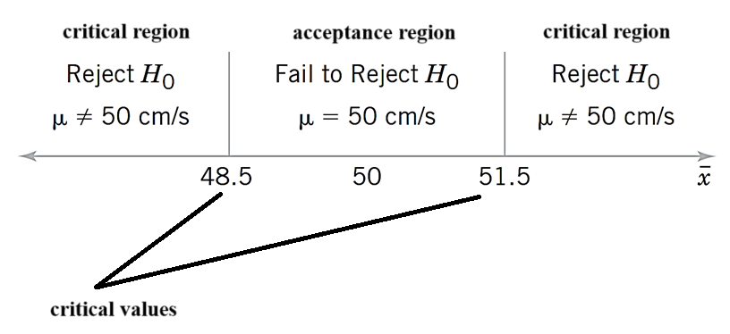

Slide 9
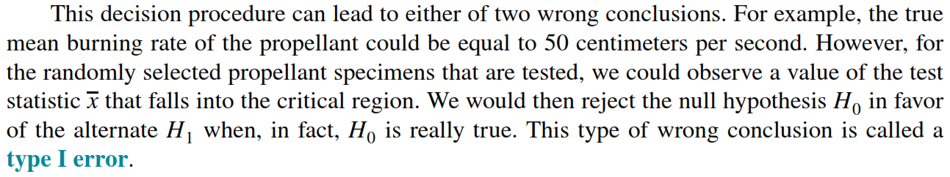
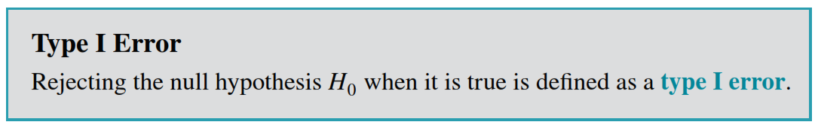
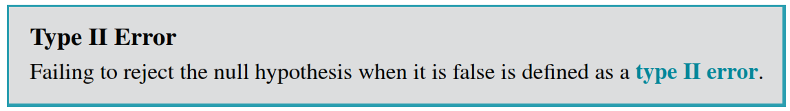

Slide 10
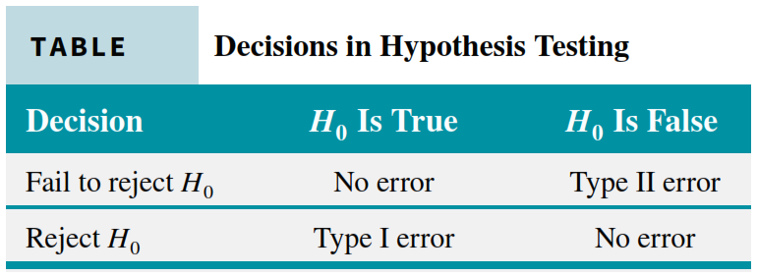

Slide 11
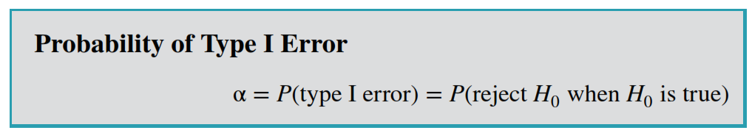
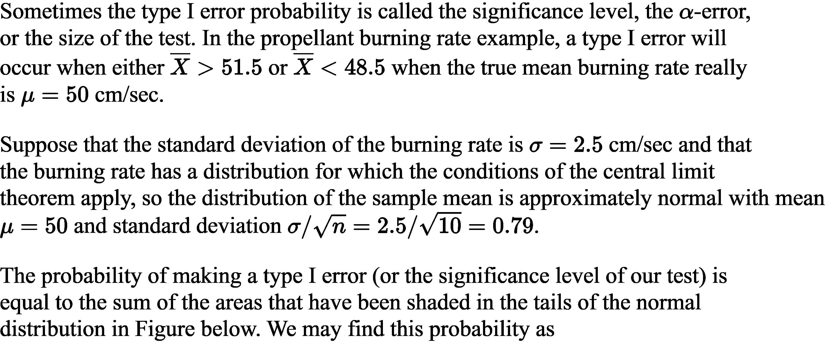

Slide 12
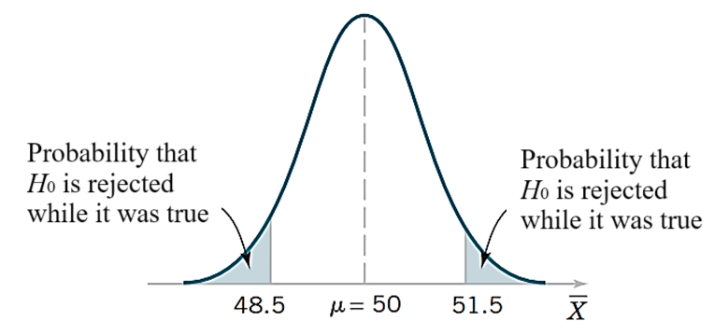
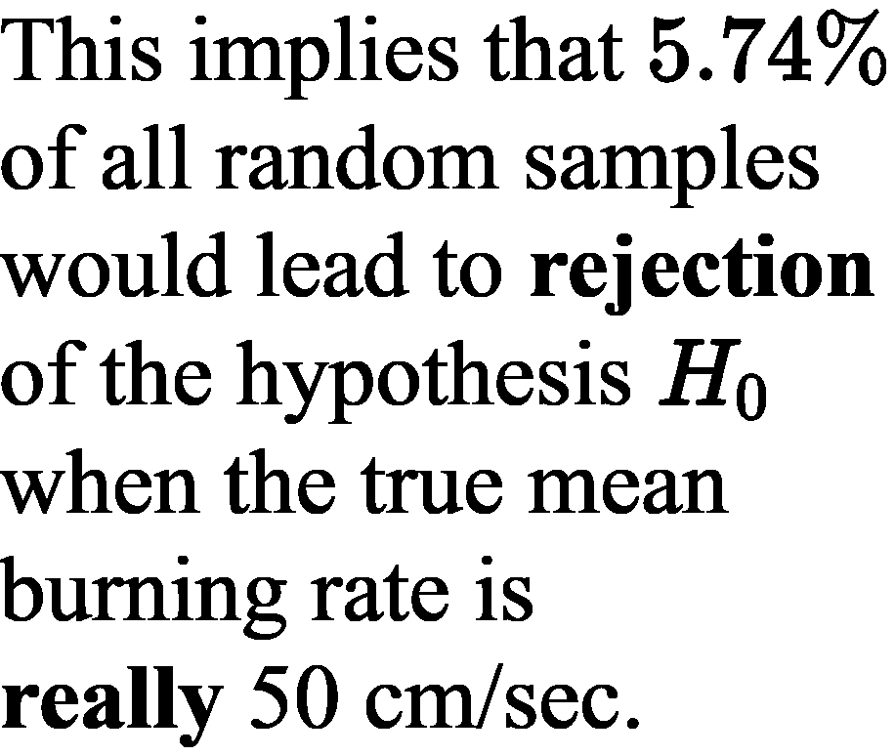
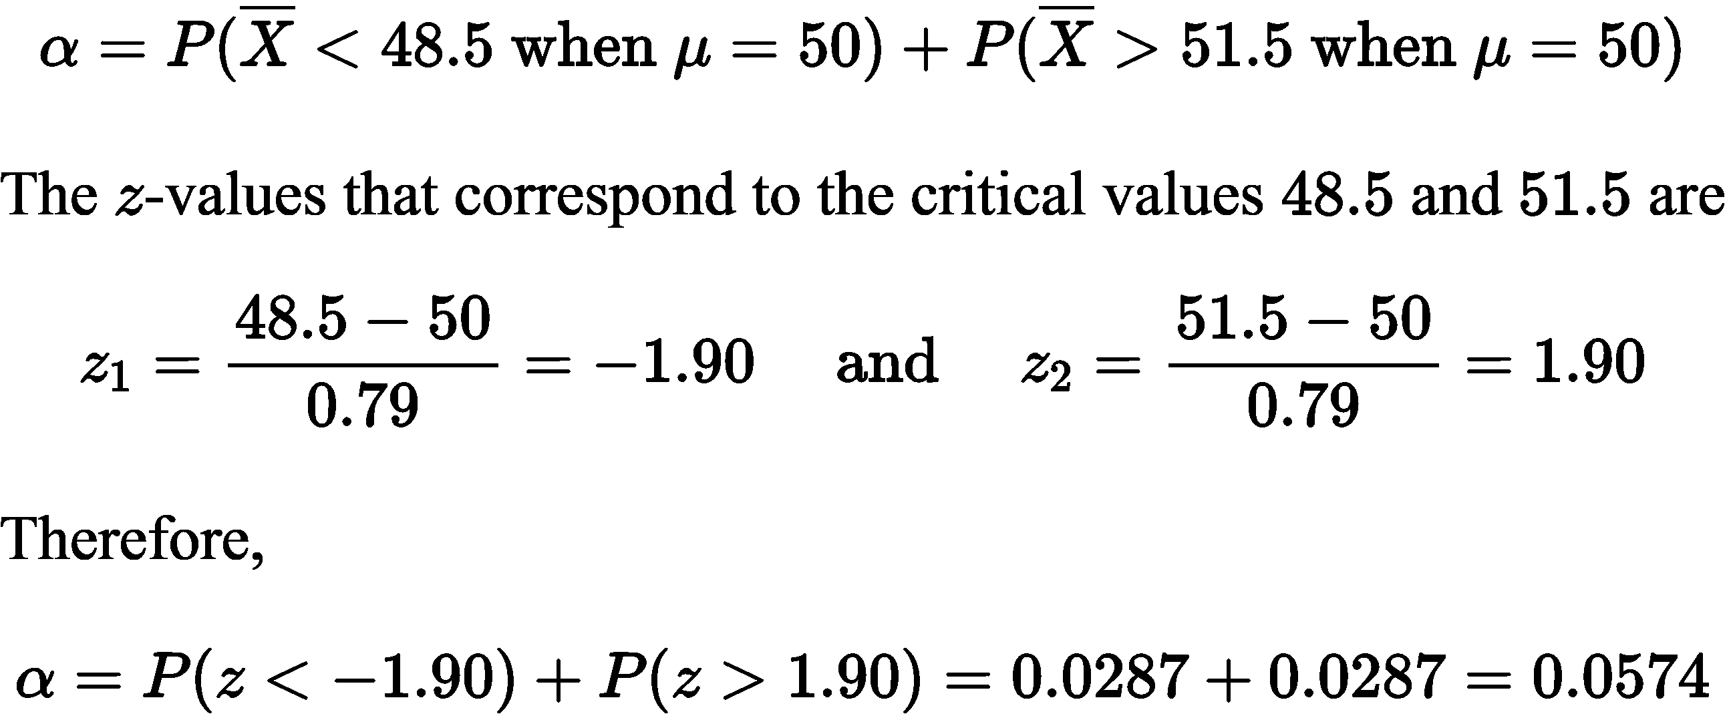
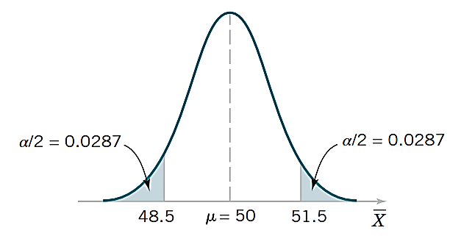

Slide 13
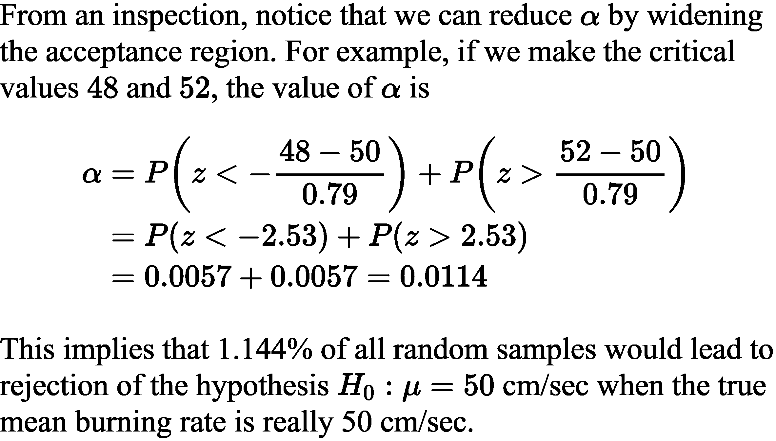
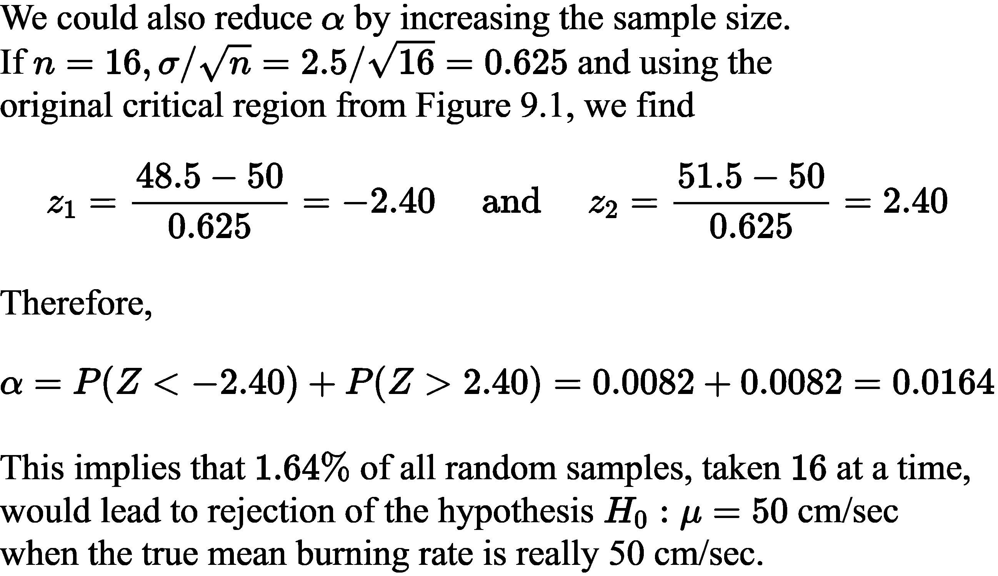
Effect of changing critical values
Effect of changing sample size

Slide 14
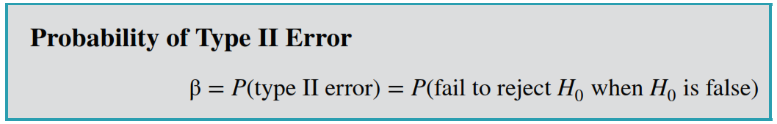
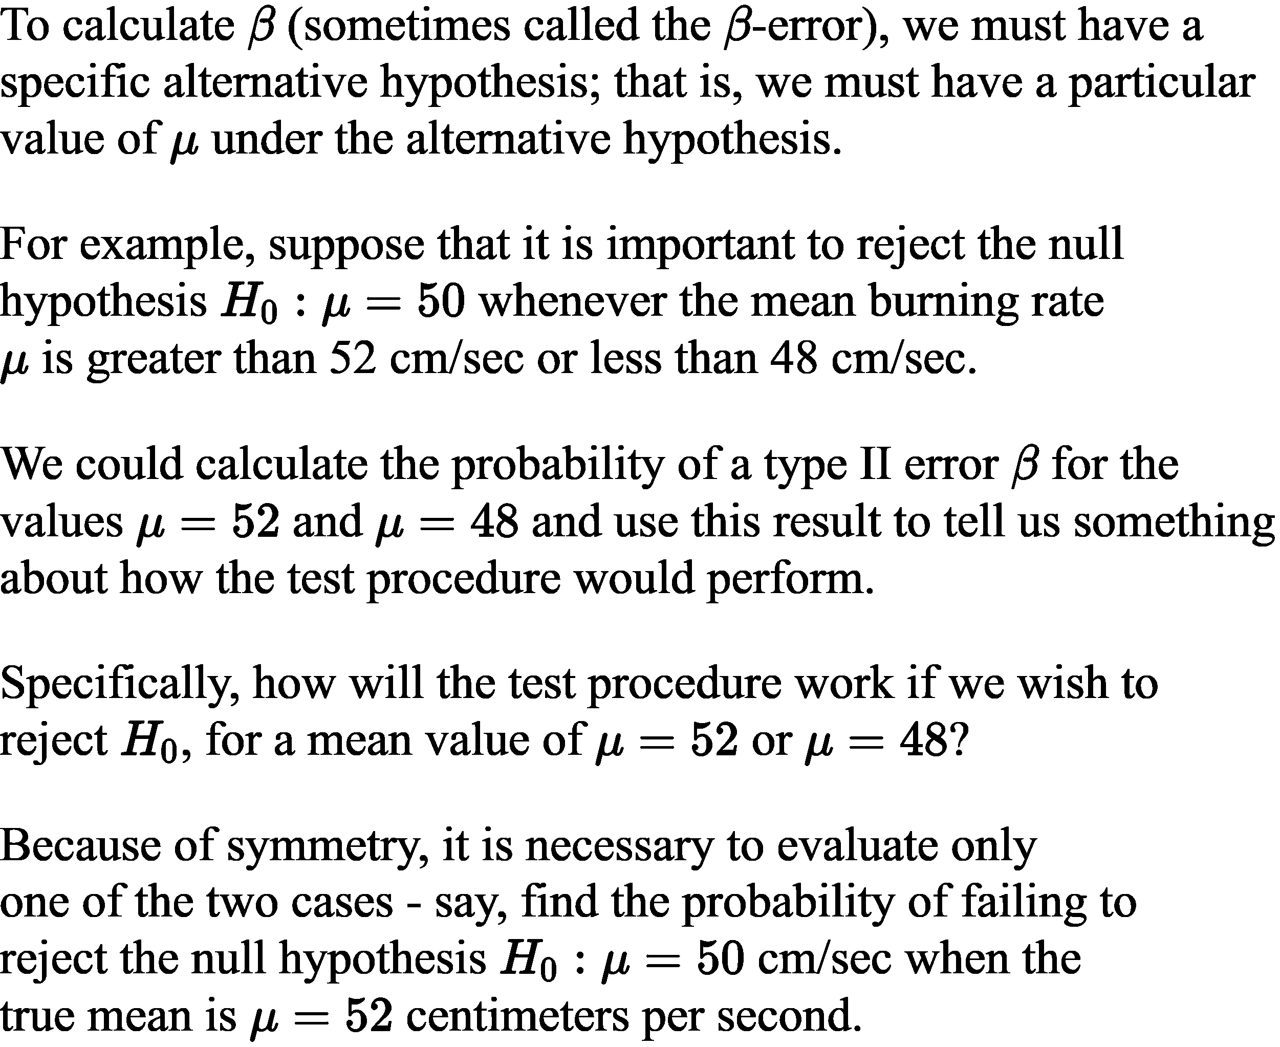

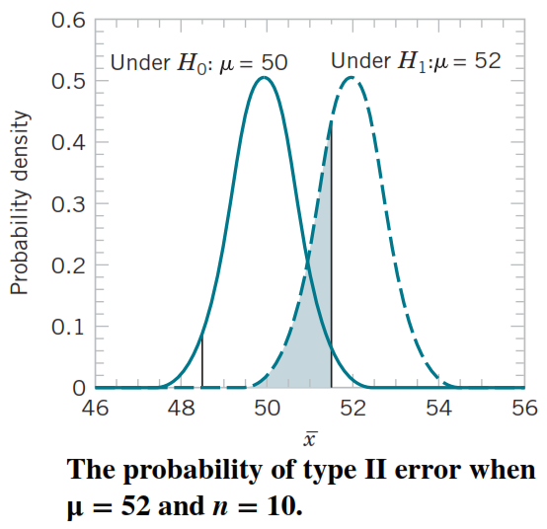

Slide 15
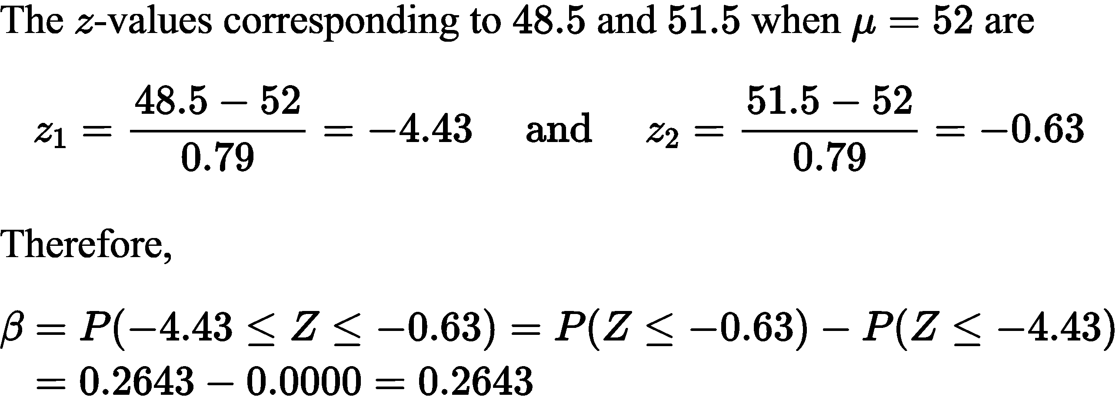
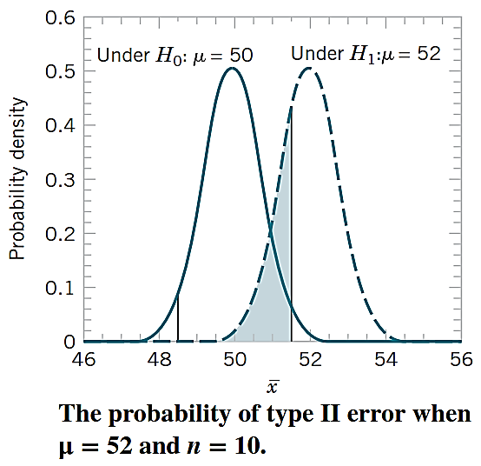
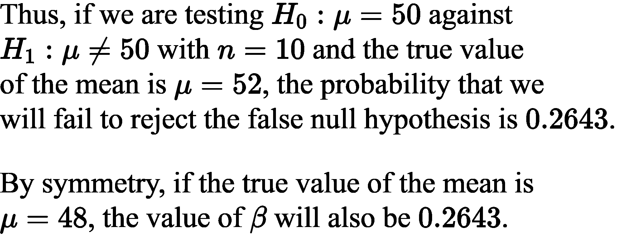

Slide 16
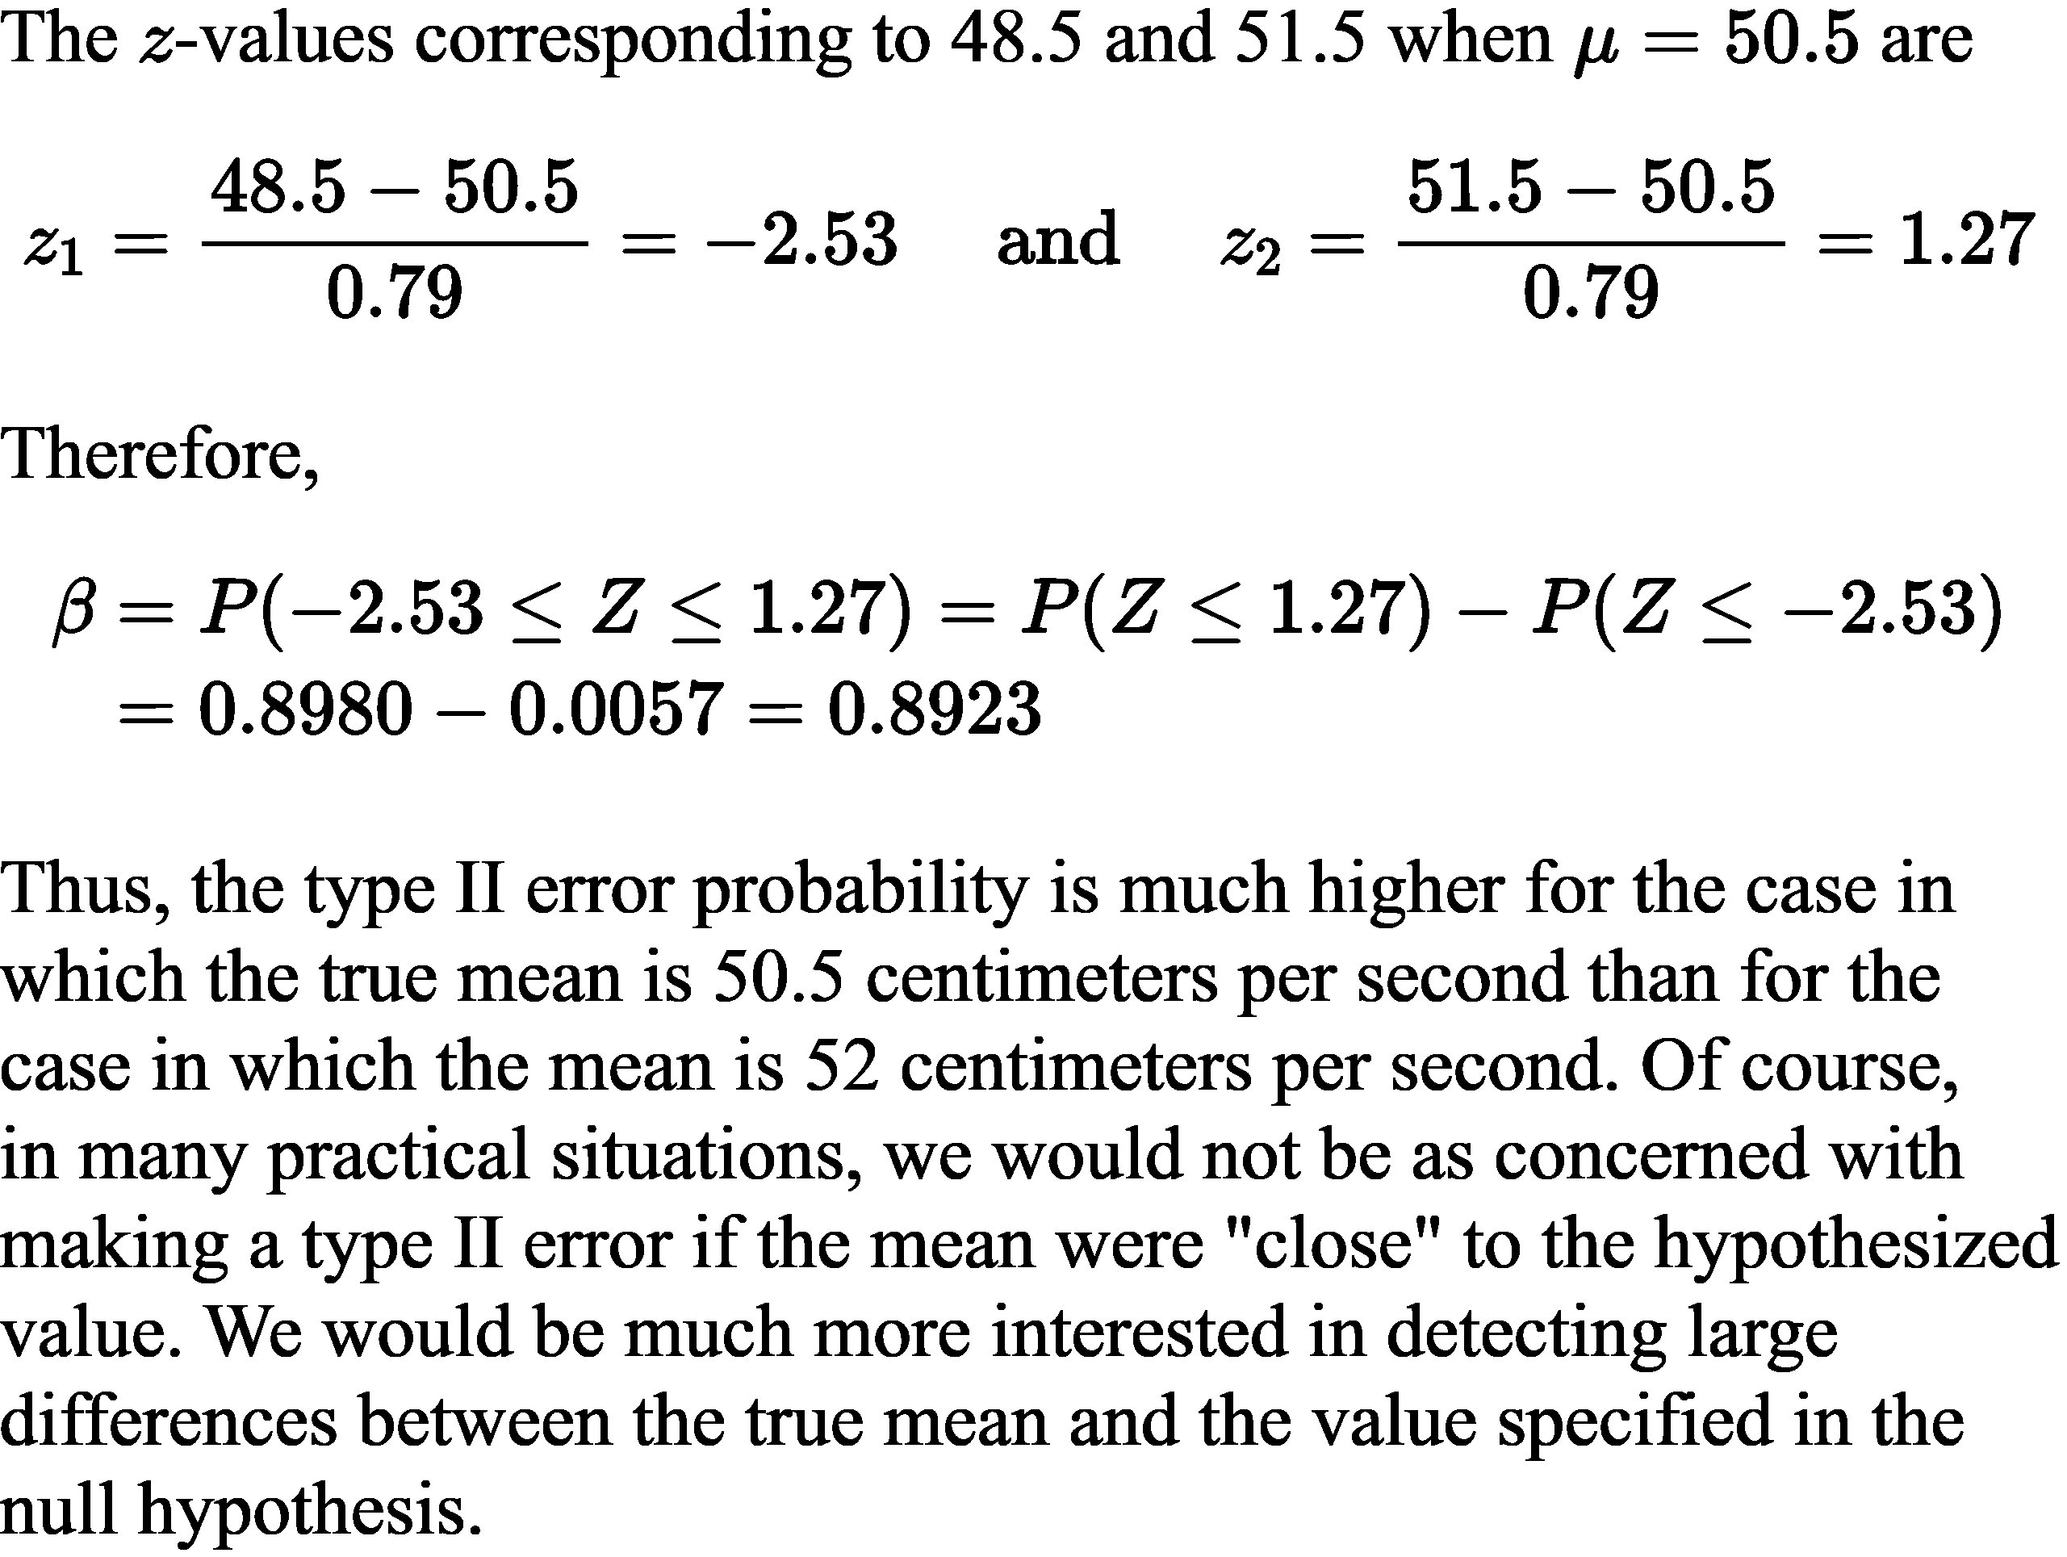
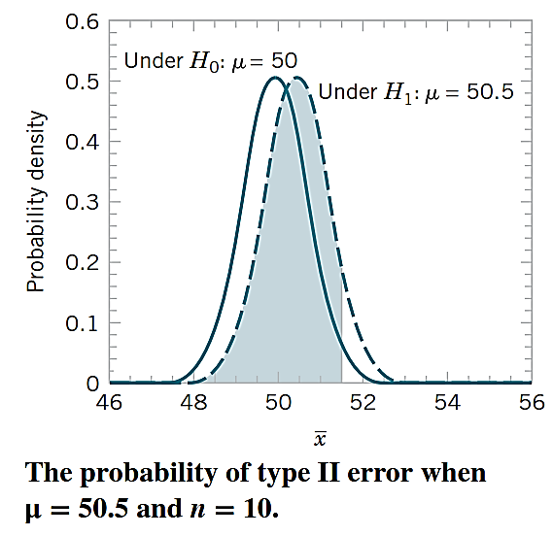

Slide 17
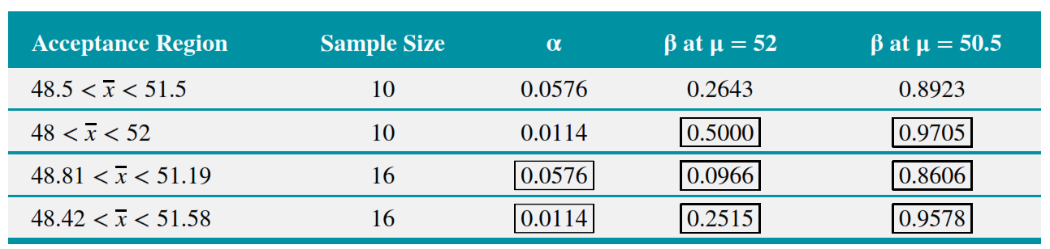
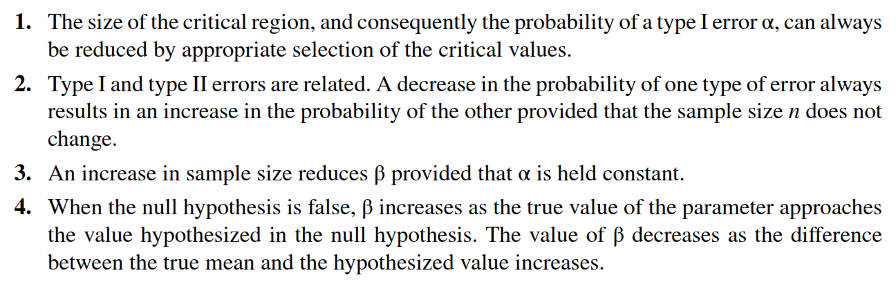

Slide 18
